Slide 1
SQL PROJECT
Ecommerce Sales Analysis

Slide 2
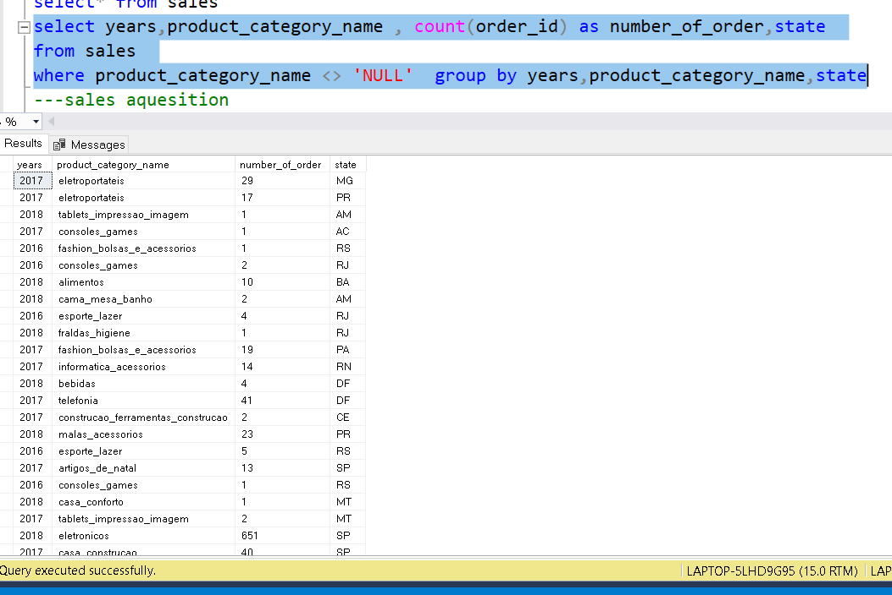
Sales by State in each year

Slide 3
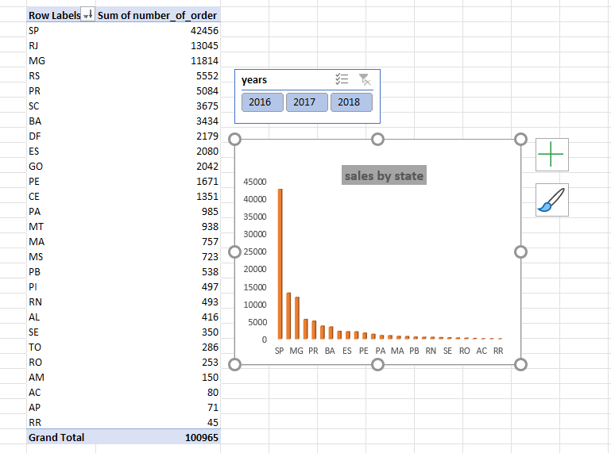

Slide 4
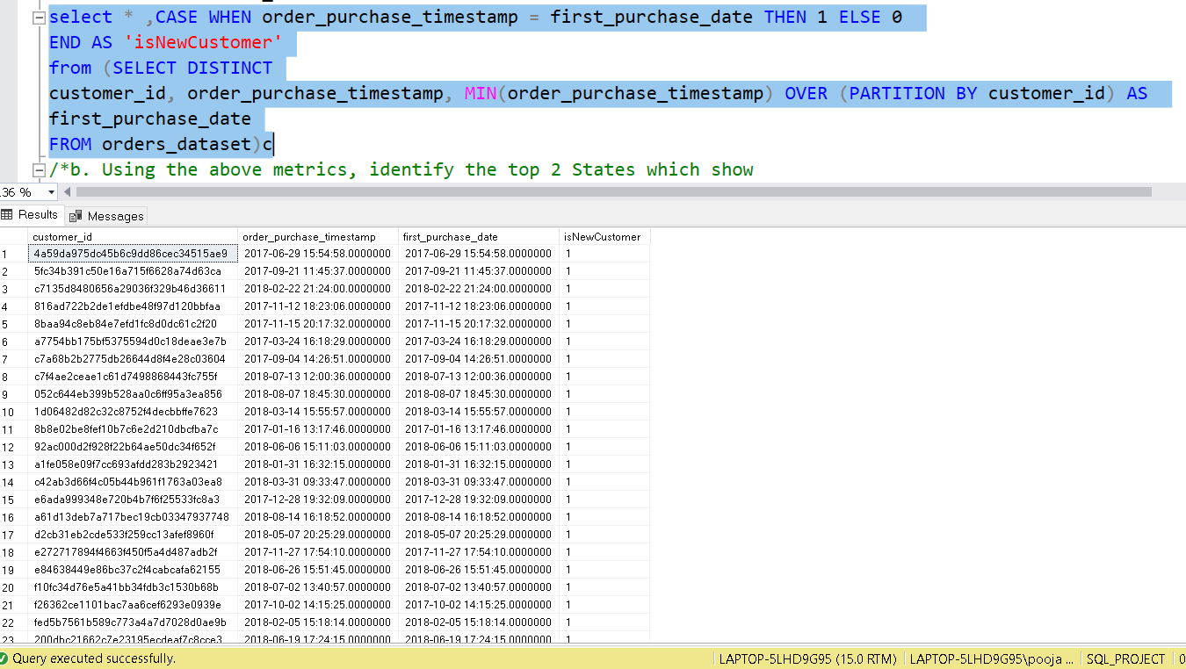
Customer Acquisition by State

Slide 5
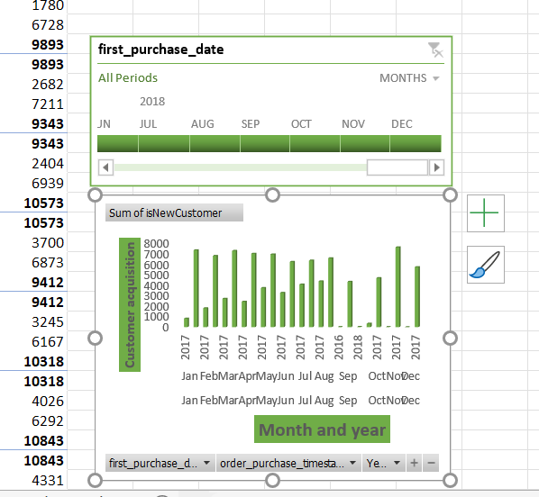

Slide 6
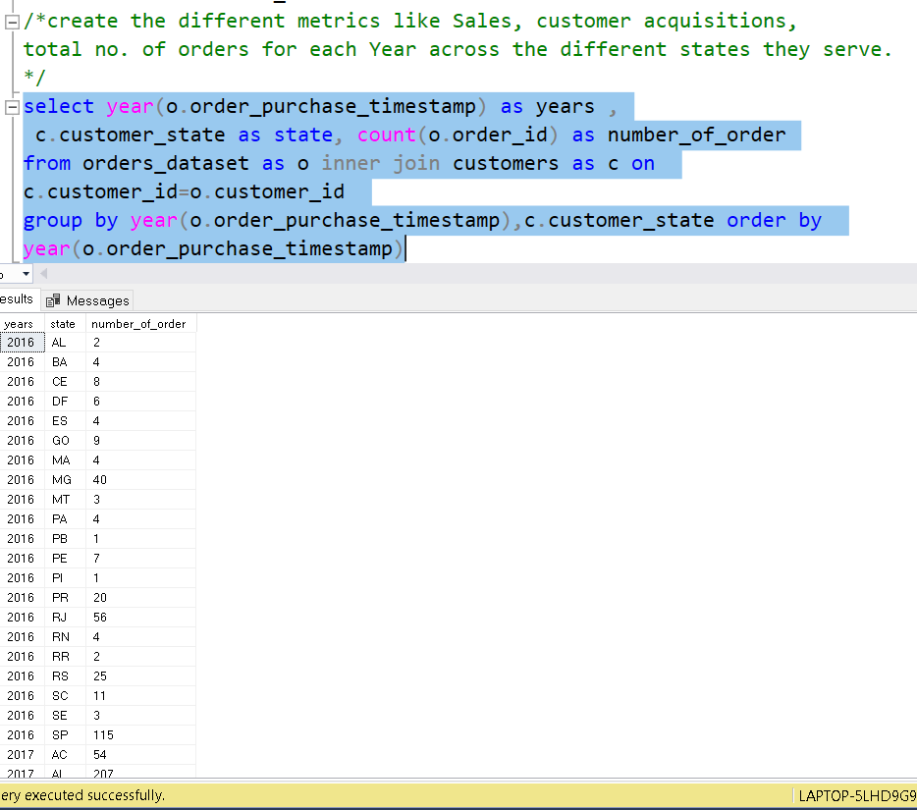
Total no. of Orders for each year by diff. states

Slide 7
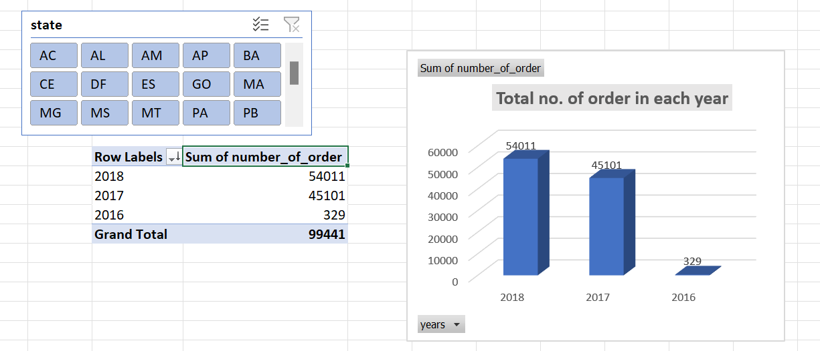

Slide 8
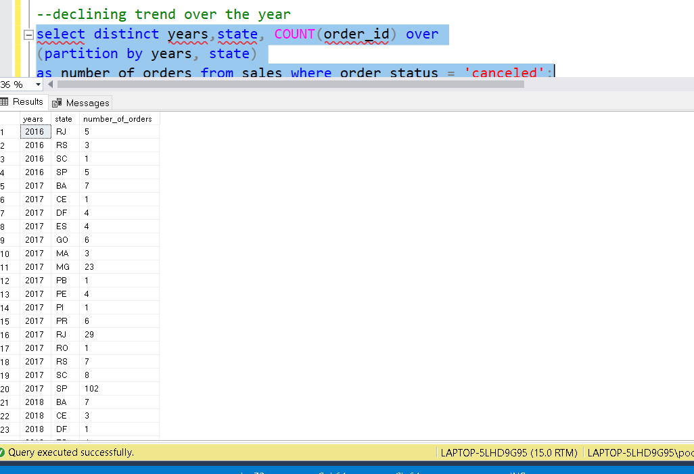
Declining trend over the year

Slide 9
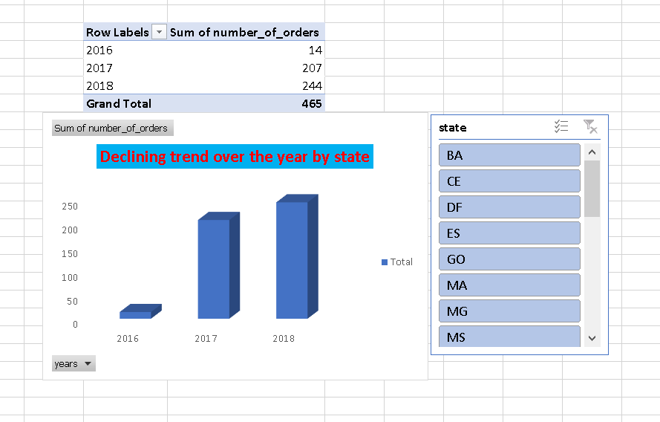

Slide 10
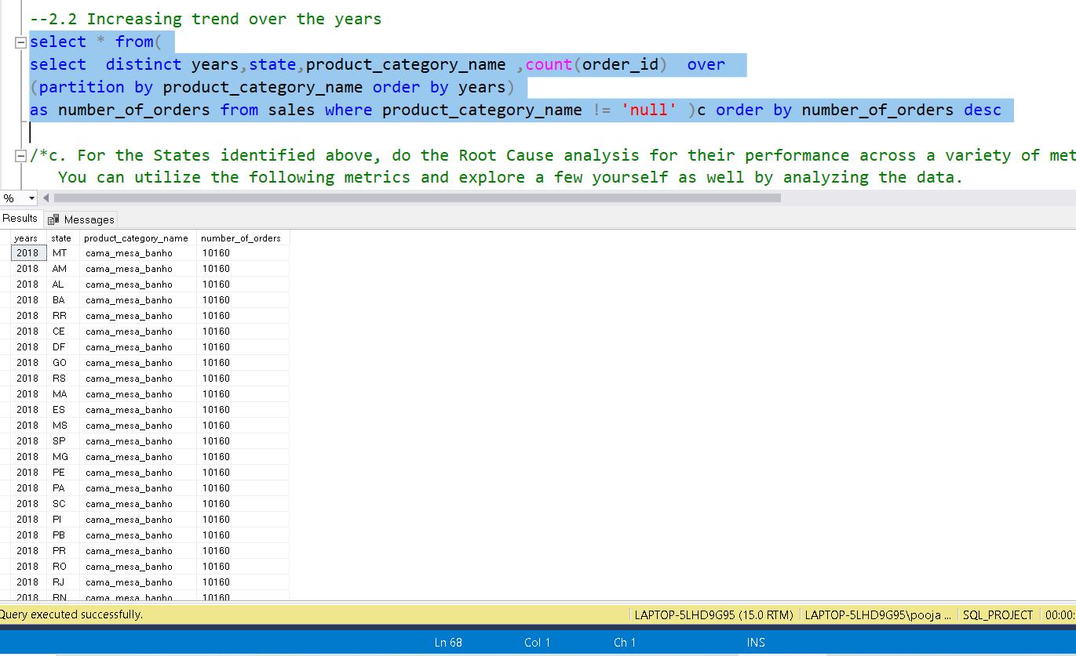
Increasing trend over the year

Slide 11
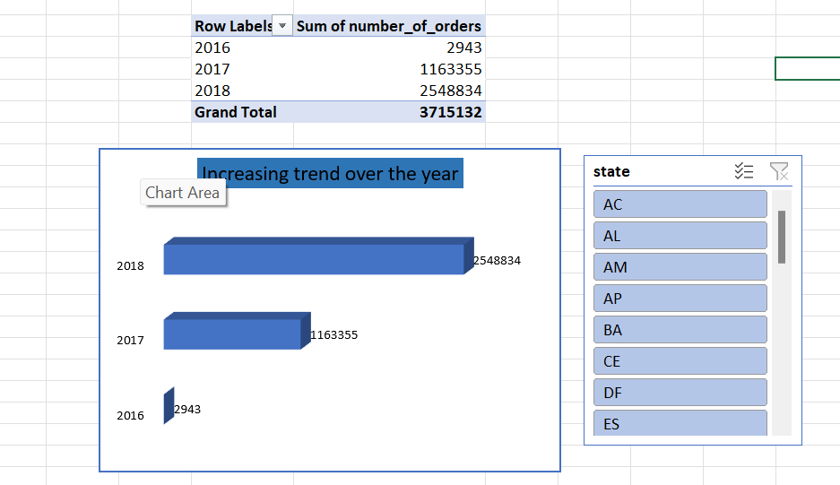

Slide 12
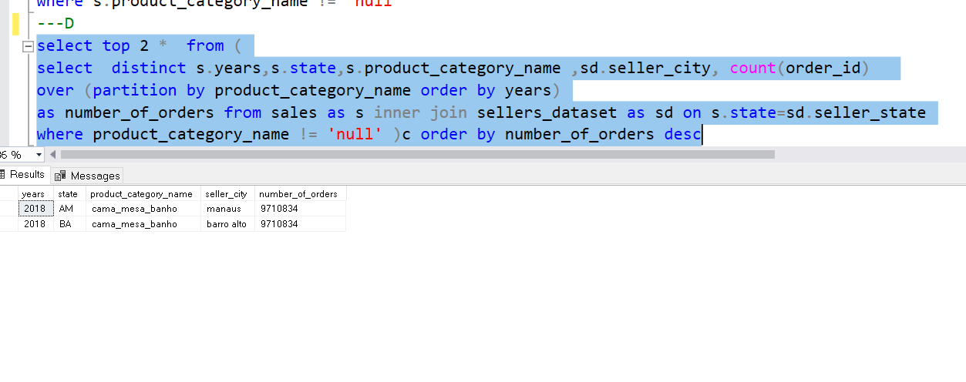
Top 2 Cities

Slide 13
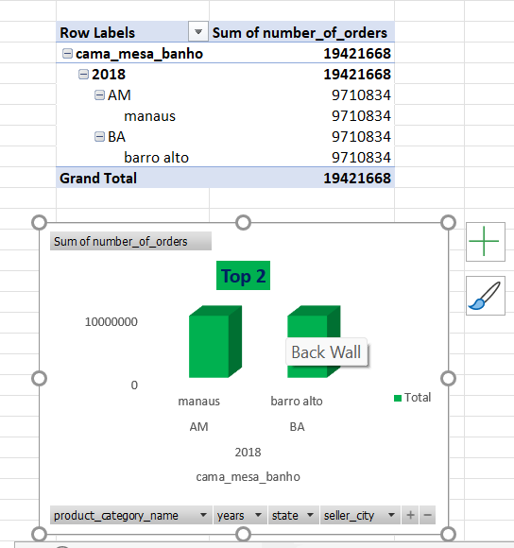

Slide 14
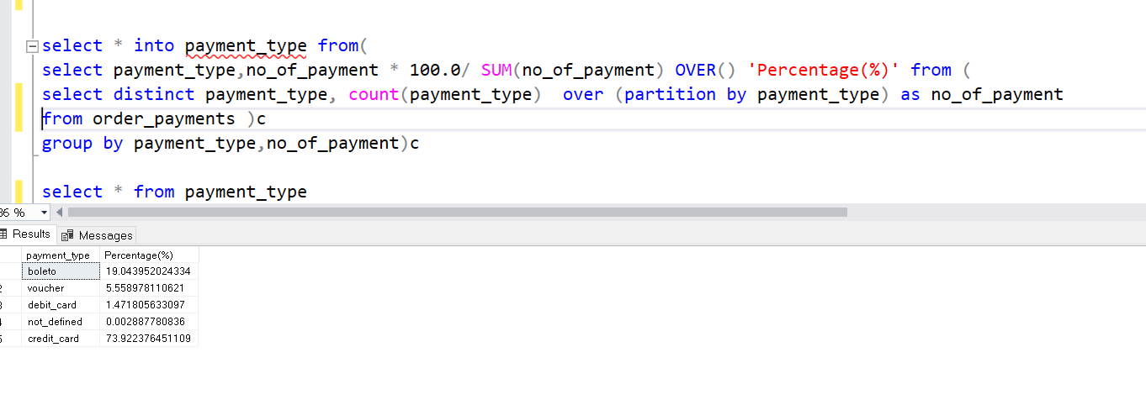
Trend in Payment Type

Slide 15
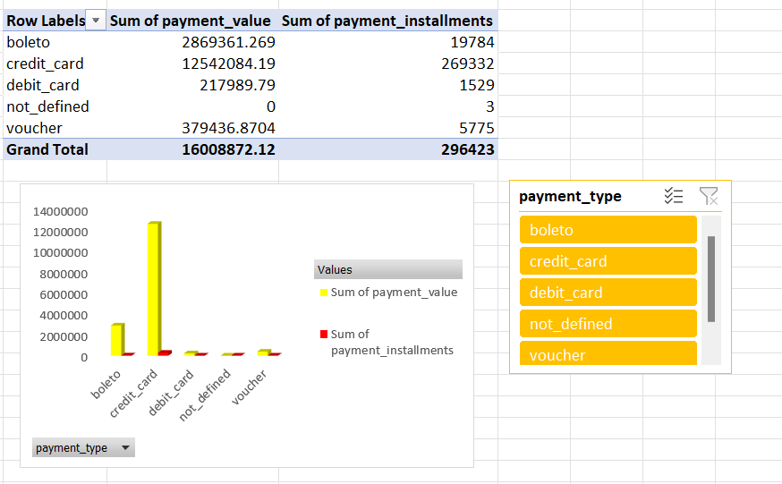

Slide 16
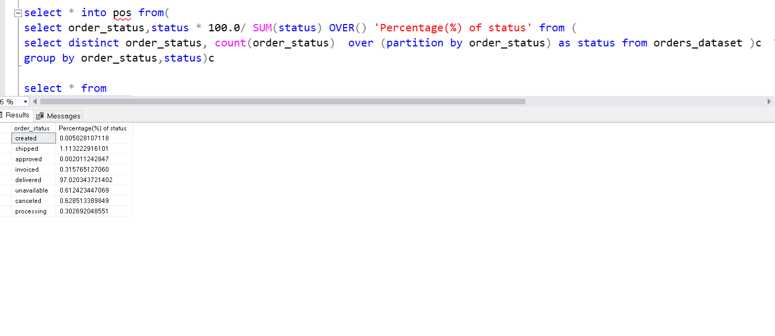
% Of Order Status

Slide 17
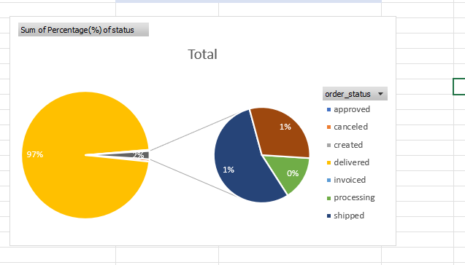

Slide 18
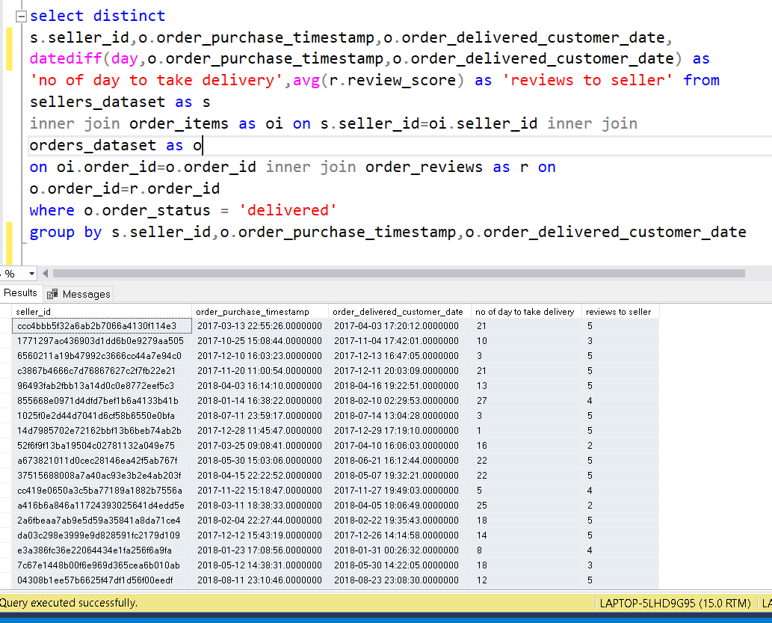
No. of days to delivery & Reviews to Sellers

Slide 19

DASHBOARD

Slide 20
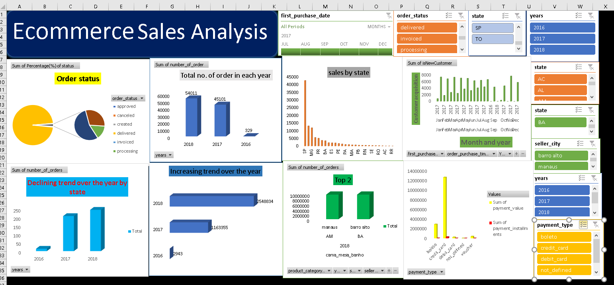

Slide 21
Improvements
Sellers should improve delivery time.
Sellers having less than 3 rating, needs to improve their product quality.
Some of state has very less sale so, companies needs to work on it .
If they concentrate on these state they can improve their business
And they earn more.
Most of the customers are using only one payment method which is credit card only. If they provide offers on other payment methods. Customers can purchase more.

Slide 22

Thank You
By- Pooja & Reema Sharma

